Slide 1

Rules for grouping the cells in Kmap

Slide 2


Slide 3



Slide 4
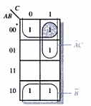
solution

Slide 5

